Slide 1
Start Your Project
Environment setup and template project
Notes on Web DB Programming

Slide 2
Outline
Notes on Web DB Programming
Set up Environment and Introduction of the template project

Slide 3
Notes on Web DB Programming
Based on M.Muscari and UCSD (anon)

Slide 4
Three-Tier Application
Presentation Tier : user interface to make requests, provide input and see results
Middle Tier: application logic
Data Management Tier: database management

Slide 5
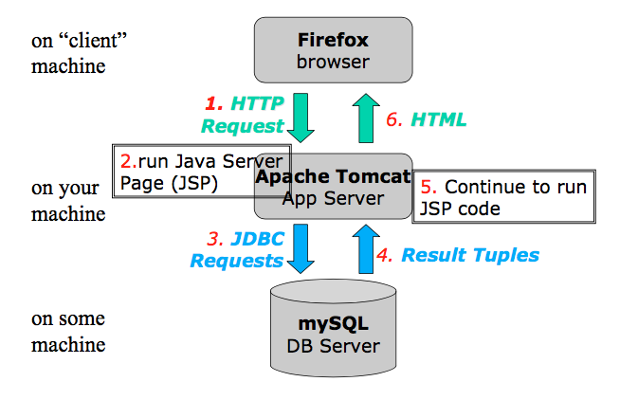
Three-Tier architecture

Slide 6
HTTP protocol
Protocol that allows web servers and clients to exchange data over the web.
It is a request - response protocol.
Clients (web browsers) send requests to web servers
GET : ask for a resource
POST : send some data (e.g. HTML form)
Server sends response
Status code (200 OK, 404 Not Found!)
HTTP is a "stateless" protocol; each time a client retrieves a Webpage, the client opens a separate connection to the Web server and the server automatically does not keep any record of previous client request.

Slide 7
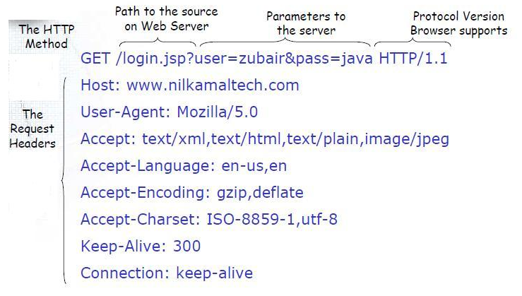
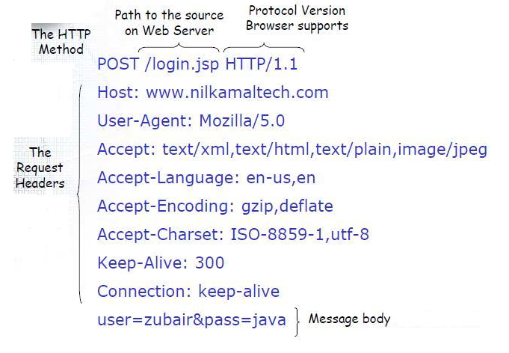
Difference between GET/POST requests
Anatomy of GET request
Anatomy of POST request

Slide 8
HTML (Hyper Text Markup Language)
Standard markup language for creating web pages
Language for creating structured documents
It consists of elements which can be nested
The HTML standard specifies a number of universally supported elements (“tags”)
Web browsers receive HTML documents from a webserver and render them into multimedia web pages.
HTML is commonly delivered as part of an HTTP response
Tutorial: https://www.w3schools.com/html/

Slide 9
HTML Tags
Common HTML tags include:
<div></div> - a logical division (section)
<p> </p> - a paragraph
<table> </table> -a table of values
<tr> </tr> - table row
<td> </td> -table column
<form></form> - a form enclosing input fields
<input></input> - an input field

Slide 10
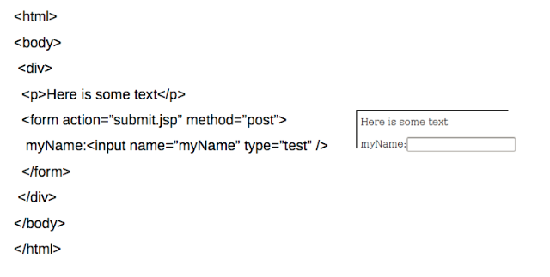
HTML Example
<html>
<body>
<div>
<p>Here is some text</p>
<form action=“submit.jsp” method=“post”>
myName: <input name=“myInput” type=“text”/>
</form>
</div>
</body>
</html>

Slide 11
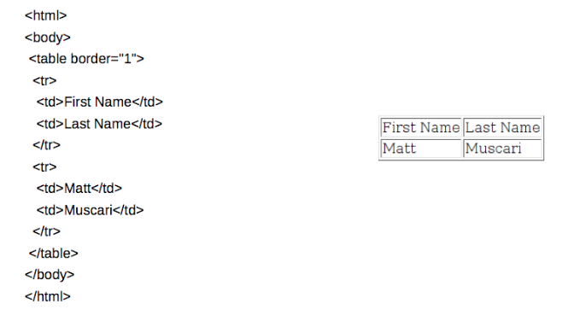
HTML Table Example
<html>
<body>
<table border=‘1’>
<tr>
<td>First Name</td>
<td>Last Name</td>
</tr>
<tr>
<td>Matt</td>
<td>Muscari</td>
</tr>
</table>
</body>
</html>

Slide 12
JSP (Java Server Pages)
A technology for building web applications that serve dynamic content
A JSP page is a text document that contains two types of text:
static data, which can be expressed in any text-based format (e.g. HTML)
JSP elements, which construct dynamic content.
The dynamic content in a JSP page is in specially marked Java code fragments (enclosed between <% and %>).
To deploy and run JSPs, a compatible web server with a servlet container, such as Apache Tomcat is required.
When executed, the Java code fragments usually generate additional HTML into the page (in our case either accessing the database or processing parameters passed to HTTP requests)
At the end, the resulting HTML page is sent to the browser to be displayed.

Slide 13
JSP Syntax
Comment
<%-- Comment--%>
Expression
<%= Java expression %>
Expression tag evaluates the expression placed in it, converts the result into String and send the result back to the client through response object.
e.g. <p>Today is <%= new Date().toString(); %> </p>
Scriplet
<% java code fragment%>
e.g. <% person.getFirstName();%>
Include
<jsp:include page="relativeURL"/>

Slide 14
JSP Implicit Objects
Object | Class
request | HttpServletRequest
response | HttpServletResponse
session | HttpSession
out | Writer

Slide 15
request
<%@ page language=“java” contentType=“text/html”%> <html> <head> <title>RequestExamplePage</title>
</head>
<body>
<% // Get the User's Name from the request out.println("<b>Hello: " + request.getParameter(”myInput") + "</b>");
%>
</body>
</html>

Slide 16
session
<%@ page language=“java” contentType=“text/html”%> <html> <head> <title>SessionExamplePage</title>
</head>
<body>
<%
HttpSession session = request.getSession(); //create a session object // Try and get the current count from the session Integer count = (Integer)session.getAttribute("COUNT"); // If COUNT is not found, create it and add it to the session
if ( count == null ) {
count = new Integer(1);
session.setAttribute("COUNT", count);
} else { count = new Integer(count.intValue() + 1);
session.setAttribute("COUNT", count);
} // Print the number of times the user has visited the site
out.println("<b>Hello you have visited this site: " + count + " times. </b>");
%>
</body> </html>

Slide 17
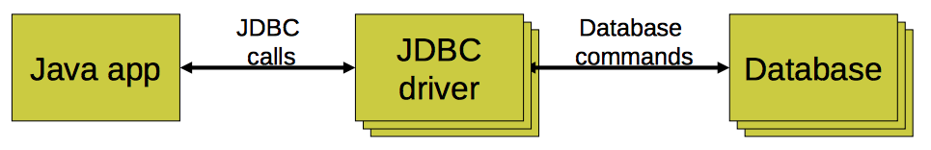
Java Database Connectivity (JDBC)
An interface to communicate with a relational database
Allows database agnostic Java code
Treat database tables/rows/columns as Java objects
JDBC driver
An implementation of the JDBC interface
Communicates with a particular database

Slide 18
JDBC steps
Connect to database
Query database (or insert/update/delete)
Process results
Close connection to database

Slide 19
1. Connect to database
Load JDBC driver
Class.forName("com.mysql.jdbc.Driver").newInstance();
Make connection
Connection conn = DriverManager.getConnection(url); 
URL
Format: “jdbc:mysql//<hostname>:<port>/<databaseName>”
jdbc:mysql://localhost:3036/BarBeerDrinkerSample

Slide 20
2. Query database
Create statement
Statement stmt = conn.createStatement();
stmt object sends SQL commands to database
Methods
executeQuery() for SELECT statements
executeUpdate() for INSERT, UPDATE, DELETE, statements
Send SQL statements
stmt.executeQuery(“SELECT ...”);
stmt.executeUpdate(“INSERT ...”);

Slide 21
2. Query database
Prepared Statements
If you want to execute dynamic or parameterized SQL queries, use a “PreparedStatement” object instead of a statement.
PreparedStatement updateStud=conn.prepareStatement("UPDATE Student SET
fname=? WHERE lastname LIKE?");
updateStud.setString(1,"John");
updateStud.setString(2,"Doe");
updateStud.executeUpdate();

Slide 22
3. Process results
Result of a SELECT statement (rows/columns) returned as a ResultSet object
ResultSet rs = stmt.executeQuery("SELECT drinker,beer from LIKES");
Step through each row in the result
rs.next()
Get column values in a row
String userid = rs.getString(“drinker”);
int type = rs.getInt(“type”);

Slide 23
3. Process results
Add a row to the users table
String str = "INSERT INTO LIKES VALUES('Bob', ‘Corona')”;
Returns number of rows in table
int rows = stmt.executeUpdate(str);

Slide 24
4. Close connection to database
Close the ResultSet object
rs.close();
Close the Statement object
stmt.close();
Close the connection
conn.close();

Slide 25
Needed tools and installation
JRE, IDE (JAVA, Eclipse for EE developers)
MySQL
Apache Tomcat (or any web server)
You will install it locally in your computer for development purposes.
JDBC

Slide 26
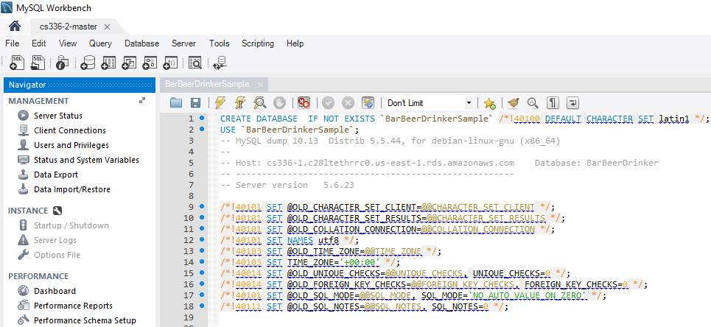
The Template Project
0. If you haven’t done it yet: import schema BarBeerDrinkerSample in your DB instance using the provided script ”BarBeerDrinkerSample.sql”. Open the script and run it in your MySqlWorkbench. (File->Open SQL script)

Slide 27
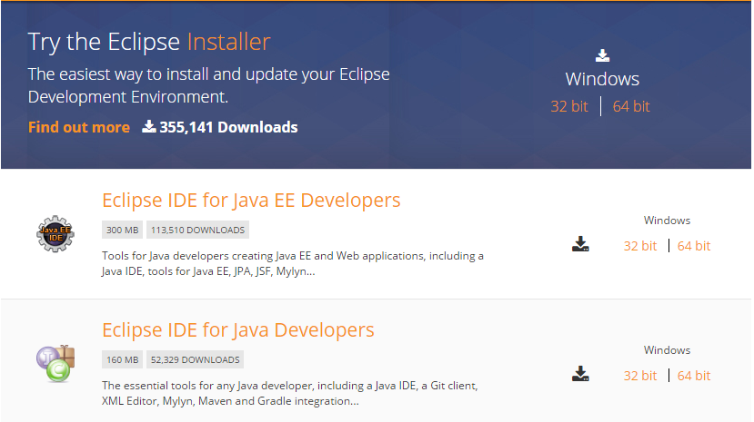
The Template Project
1. Download Eclipse IDE for Java EE Developers
https://eclipse.org/downloads/eclipse-packages/

Slide 28
The Template Project
2. Open eclipse and import the template project (cs336Final.war)
File – Import – Web – WAR file

Slide 29
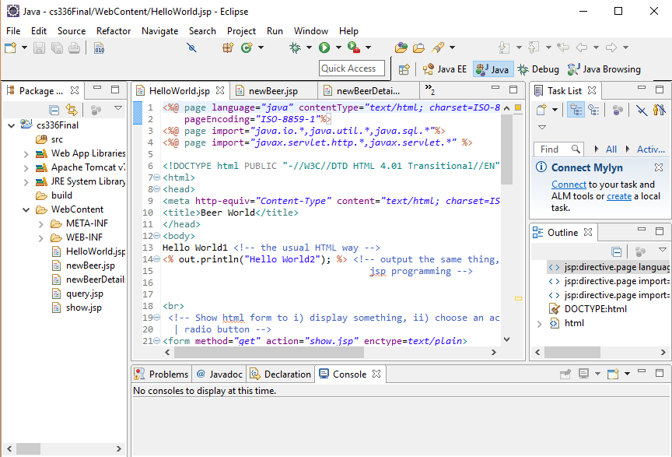

Slide 30
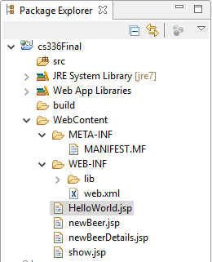
The Template Project
3. Structure of the template
Java code
Meta data of your website
HTML, JSP, JS, CSS code

Slide 31
The Template Project
4. Set your Tomcat server in eclipse
If you don’t have tomcat yet go to: https://tomcat.apache.org/download-70.cgi
and download the binary distribution for your OS.
After go back to eclipse:
Windows - Preference - Server - Runtime Environment - Add - Apache Tomcat v7.0 or
Eclipse- Preferences - Server - Runtime Environments - Add - Apache Tomcat v7.0

Slide 32
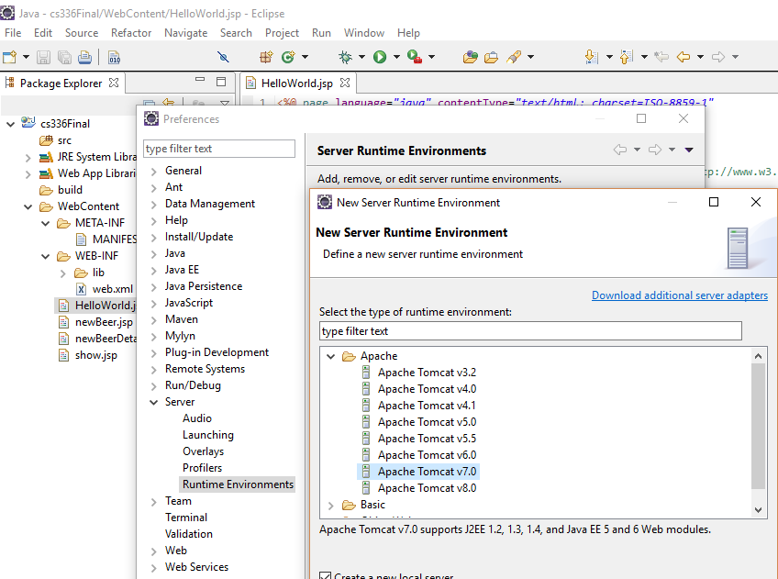

Slide 33
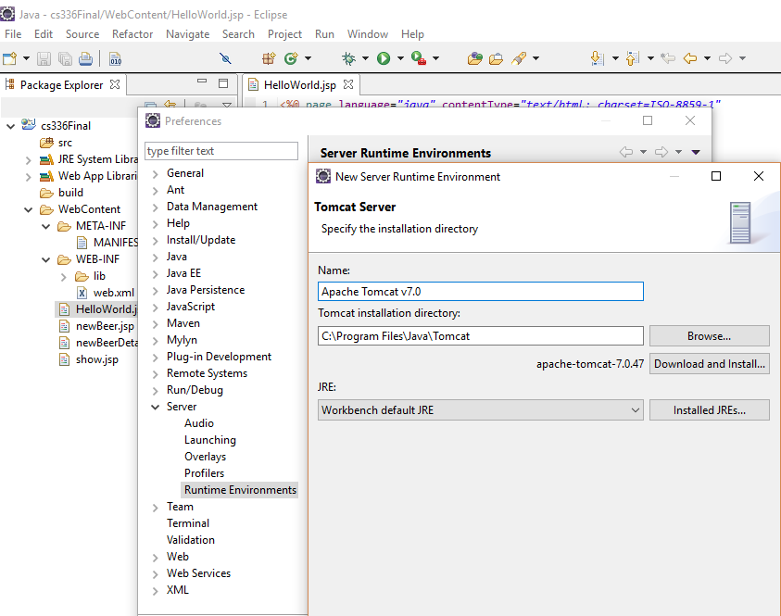

Slide 34
The Template Project
5. Run the project based on Tomcat 7
Right click on the project - Run as - Run on Server - Apache - Tomcat7

Slide 35
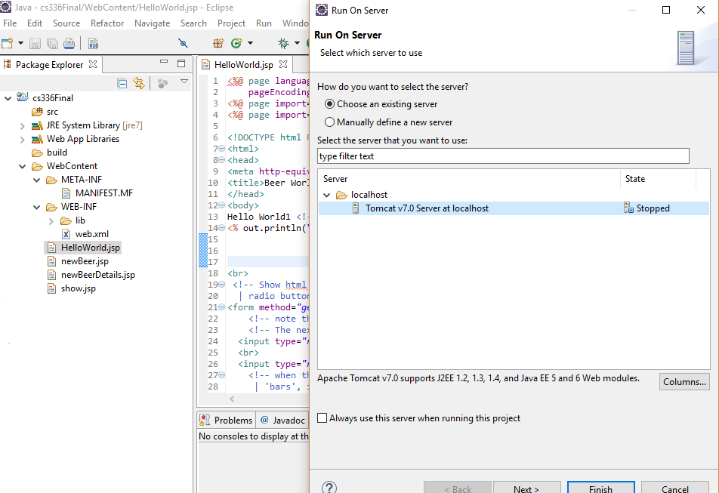

Slide 36
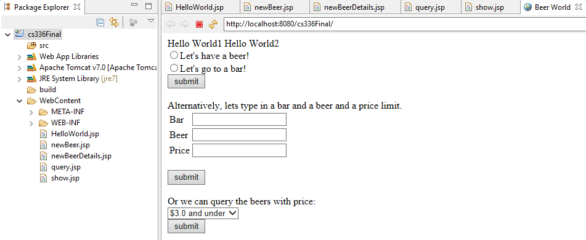
The Template Project
Now you can see your project home page, index.html page.

Slide 37
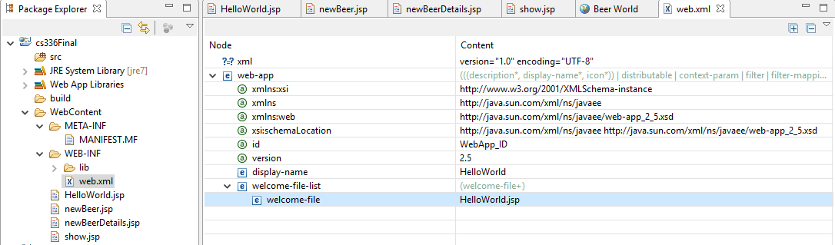
The Template Project
6. The home page is set in web.xml, you can set your own page if you want.

Slide 38
The Template Project
7. Connect to your own db instance in Project
In order to interact with db instance (add, delete, update, select), you need to set your own database address in the project.
At the same time, the database username and password are both essential.
Replace the database information with your own database information as follows.

Slide 39
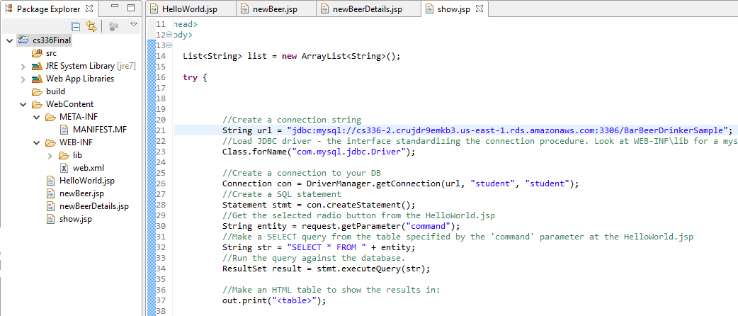
The Template Project
Hostname: Port/Schema
Username and Password

Slide 40
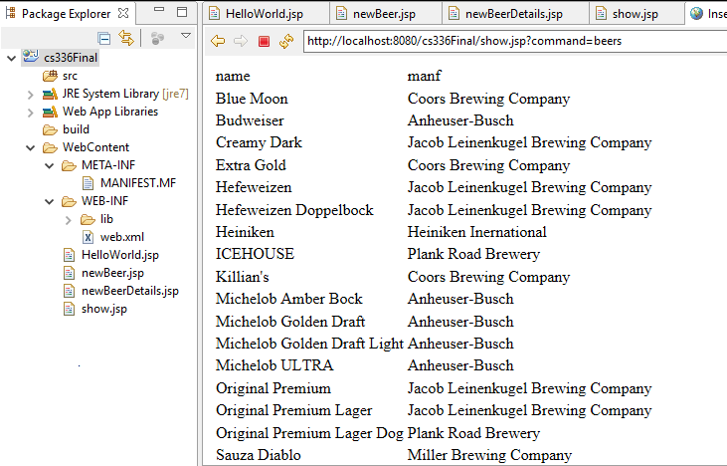
The Template Project
8. Let’s have a beer
Select the radio button and then click submit below it

Slide 41
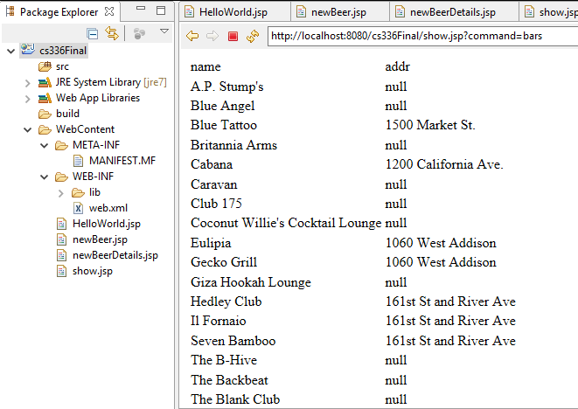
The Template Project
9. Let’s go to a pub
Select the radio button and then click submit below it

Slide 42
The Template Project
10. Insert a tuple into sells table
Input pub name, beer name and cost, then click submit.
You can find a new record inserted into your database after submitting this form.
-NOTE: since you insert a tuple in sells table which has FKs in the bar and beer table, make sure the beer and bar you insert already exist in these two tables.

Slide 43
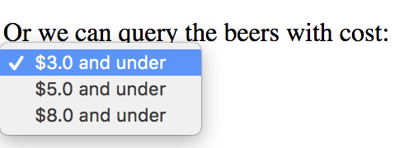
The Template Project
11. Query the beers with cost
Choose one option from the dropdown menu, then click submit.

Slide 44
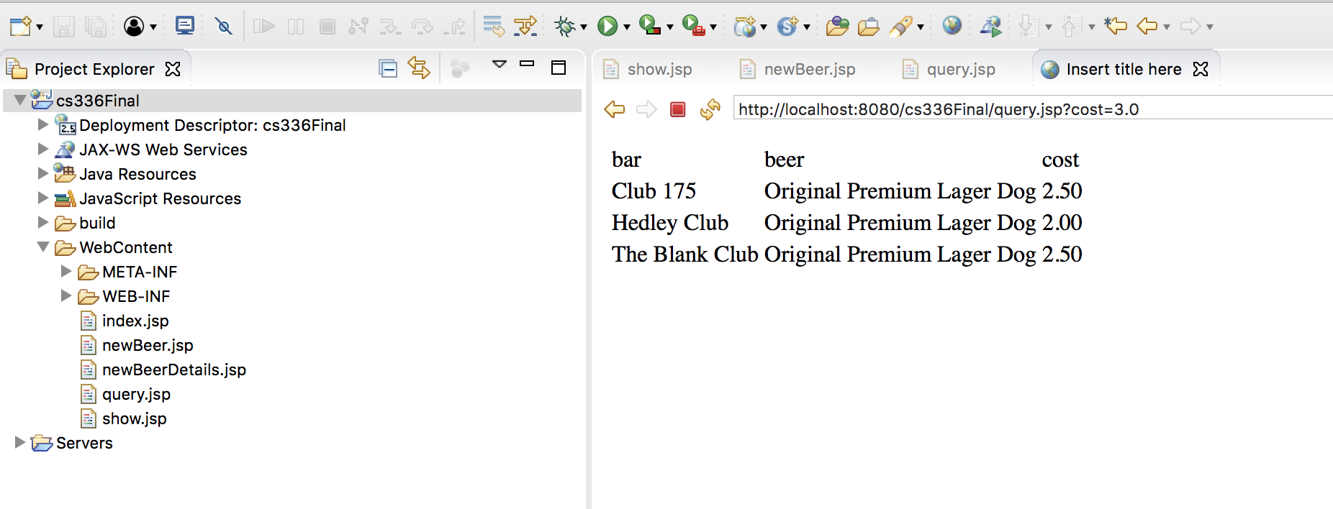
The Template Project
Query the beers with cost <= 3

Slide 45
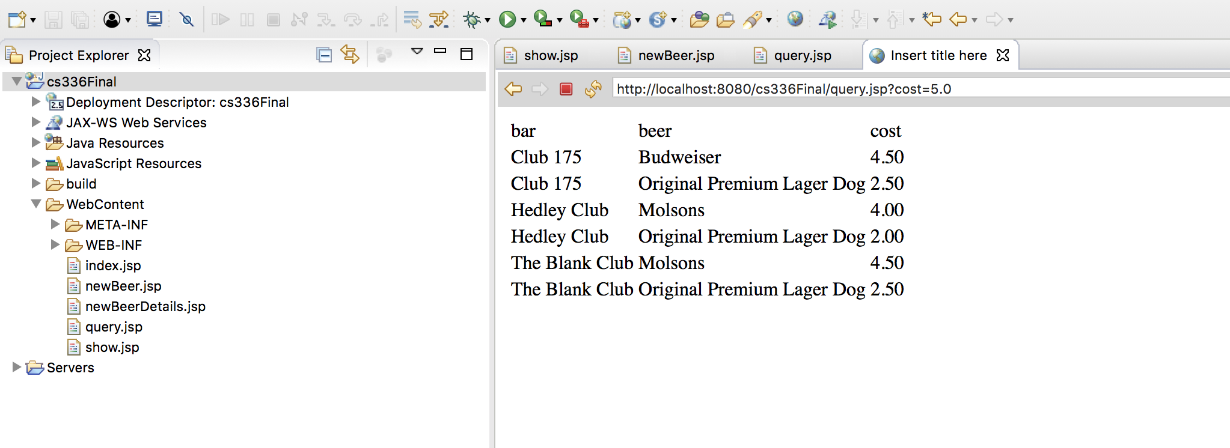
The Template Project
Query the beers with cost<= 5

Slide 46
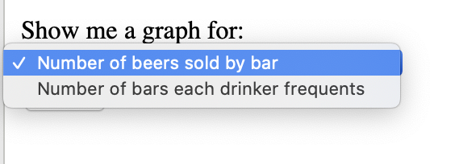
The Template Project
12. See a graph for either the number of beers sold by bar or number of bars each drinker frequents
Choose one option from the dropdown menu, then click submit.
Charts documentation: https://www.highcharts.com

Slide 47
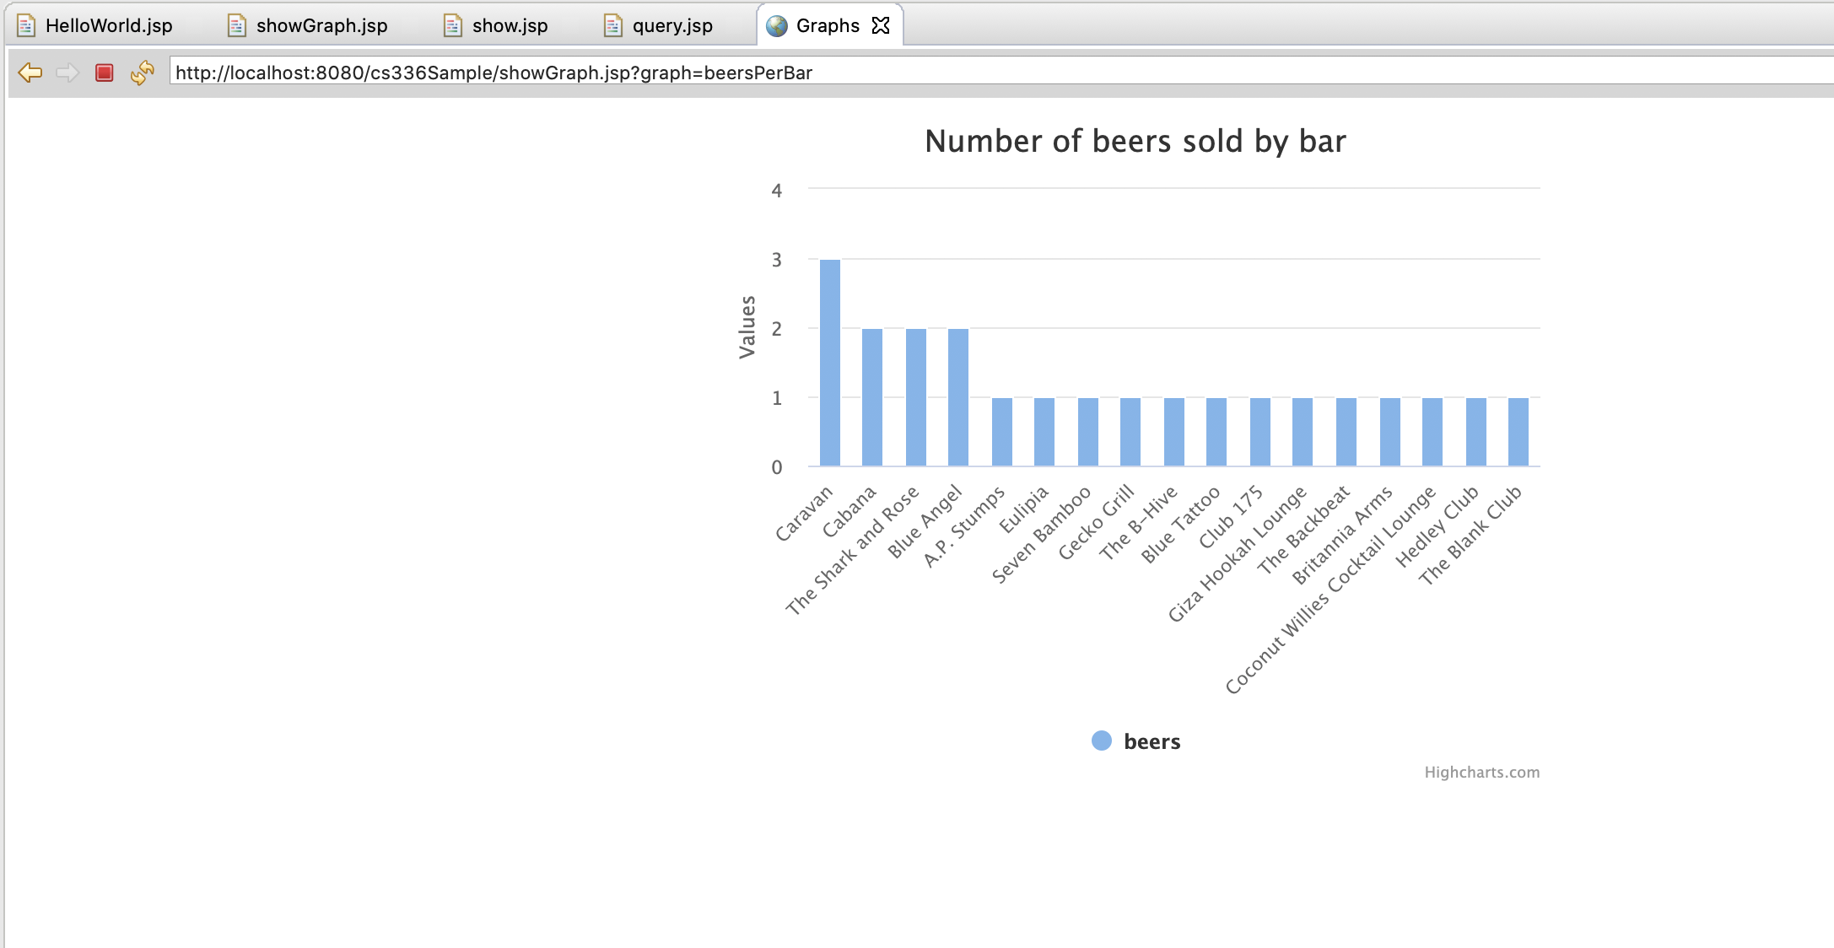
The Template Project
Number of beers sold by bar

Slide 48
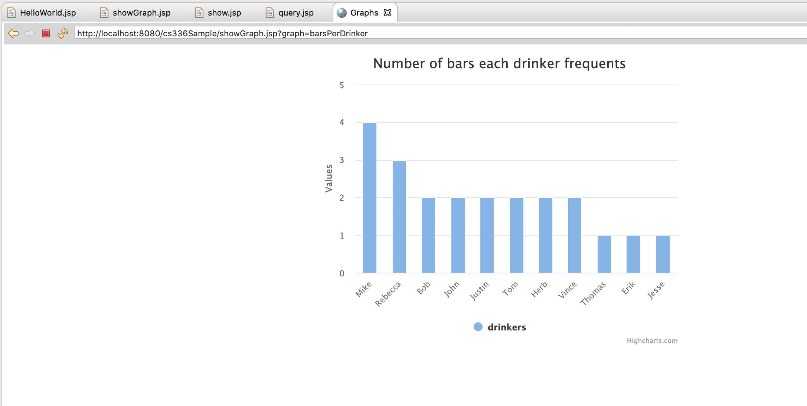
The Template Project
Number of bars each drinker frequents

